Slide 1
Music and its Cultures II
I. The Symphony and Symphony Concert, c.1800-1900

Slide 2
1. The Growing Prestige of the Symphony 2. Beethoven’s ‘Heroic’… 3. … and the ‘Symphony Concert’ 4. Mahler and the ‘Chain of Being’

Slide 3
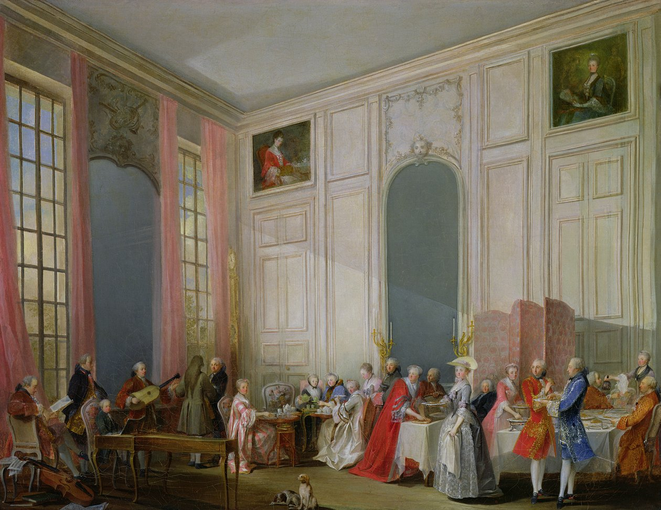
Le Thé à l'anglaise servi dans le salon des quatre-glaces au Palais du Temple à Paris, Michel-Barthélémy Ollivier (1766)

Slide 4
Johann Abraham Schulz on the Symphony
In Johann Sulzer, Allgemeine Theorie der schönen Künste (‘A General Theory of the Fine Arts’) (1771–74), vol. 2, p. 1121
‘The symphony is particularly suited for the expression of greatness, solemnity, and grandeur. Its goal is to prepare the listener for important music or, in a chamber concert [Cammerconcert], to summon all the magnificence of instrumental music … The chamber symphony [Kammersymphonie], which is an independent whole, aiming at no following music, attains its purpose only through a sonorous, brilliant, and fiery style. The [opening] Allegros of the best chamber symphonies contain great and bold ideas – powerful bass melodies and unisons; concerting middle parts; free imitations; often a fugally treated theme; sudden transitions and digressions from one theme to another, which are more striking the weaker the connection is; and considerable gradations of loud and soft, especially the crescendo, which is of the greatest effect when it is used together with an ascending melody which increases in expression.’

Slide 5
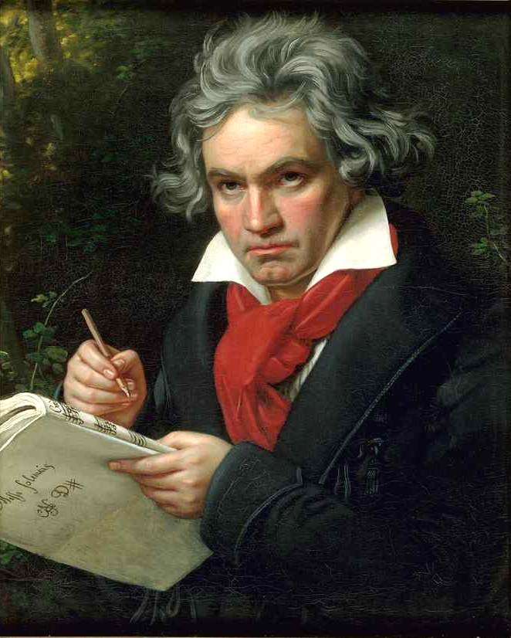
Ludwig van Beethoven (1770-1827)

Slide 6
Beethoven in context
Composing at a time of social change: public concerts in larger spaces demanding bigger works…
Technical and expressive change: growth of support networks for bourgeois music
Aesthetic change: supremacy of vocal music questioned and replaced by supremacy of instrumental music
Immanuel Kant (Critique of Judgement, 1790,§53, ‘Comparison of the Aesthetic Value of the Fine Arts’): ‘[M]usic, since it merely plays with sensations, has the lowest place among the fine arts (just as it may have the highest among those we assess by their agreeableness as well.)’

Slide 7
Beethoven in context
E. T. A. Hoffmann (1810, rev. 1813)
‘When we speak of music as an independent art, we should properly refer only to instrumental music which, scorning the assistance and association of another art, namely poetry, expresses that peculiar property which can be found in music only? It is the most romantic of all the arts, one might almost say the only really romantic art, for its sole object is the expression of the infinite. […] Music discloses to man an unknown kingdom, a world having nothing in common with the external sensual world which surrounds him and in which he leaves behind him all in order to abandon himself to an inexpressible longing.’
‘Beethoven’s Instrumental Music’

Slide 8
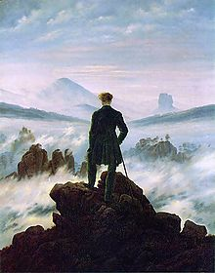
Romanticism
Cultural ‘movement’ around the turn of the nineteenth century
Focus turned inward: exploration of self and relationship to others and to nature; search for the divine in the self and/or in nature
‘Sublime’ rather than beautiful
Imagination and inspiration placed higher than rational thought
‘Feeling’ beyond language of central importance
Music and poetry as highest of all the arts and of human endeavour
Often ‘revolutionary’ attitude towards established social/ political norms
Caspar David Friedrich,
Der Wanderer über dem Nebelmeer
(c.1818)

Slide 10
1. Symphonic Prestige 2. Beethoven’s ‘Heroic’… 3. … and the ‘Symphony Concert’ 4. Mahler and the ‘Chain of Being’

Slide 11
Beethoven and the Symphony
Composed between 1799 and 1824
Generally split into three groups:
(a) Nos. 1 and 2 (‘Early’); (b) Nos. 3 – 8 (‘Middle’ or ‘Heroic’); (c) No. 9 (‘Late’)
Example: ‘Eroica’ Symphony (No. 3 in Eb major, Op. 55)
See Scott Burnham, Beethoven Hero (Ch. 1 – see Resourcelist!) for detailed historical interpretations

Slide 12
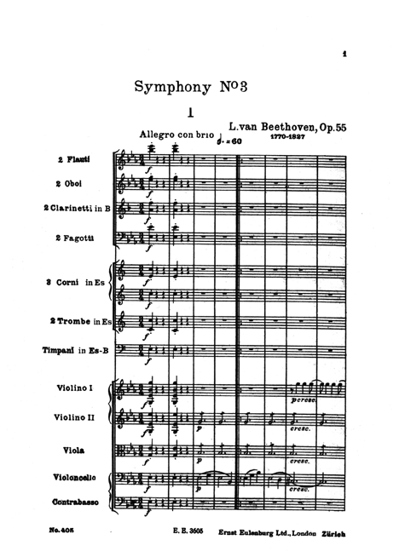
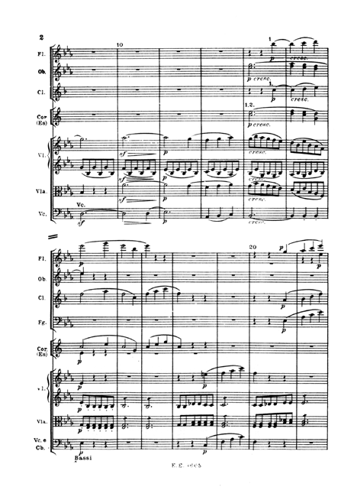

Slide 13
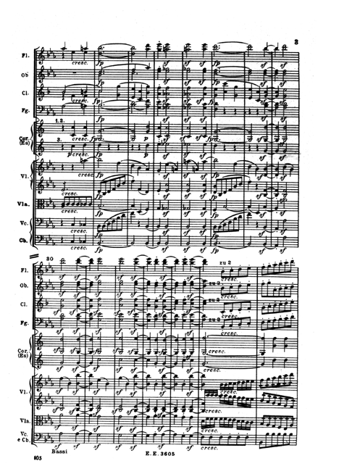
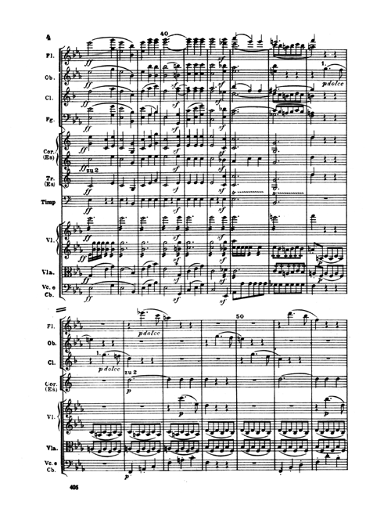

Slide 14
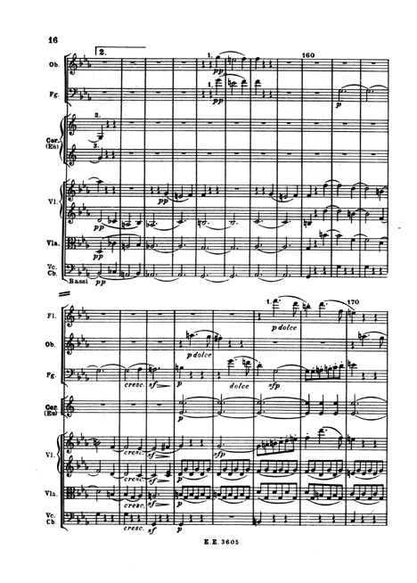
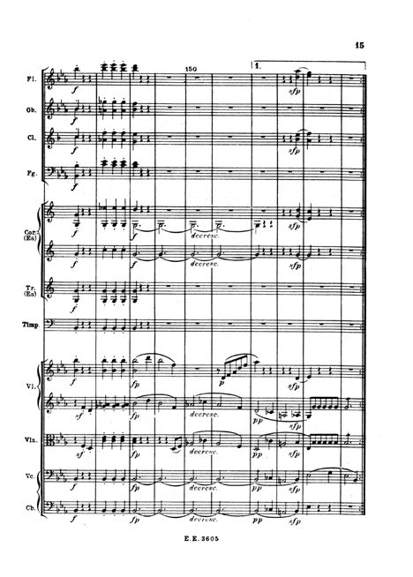

Slide 16
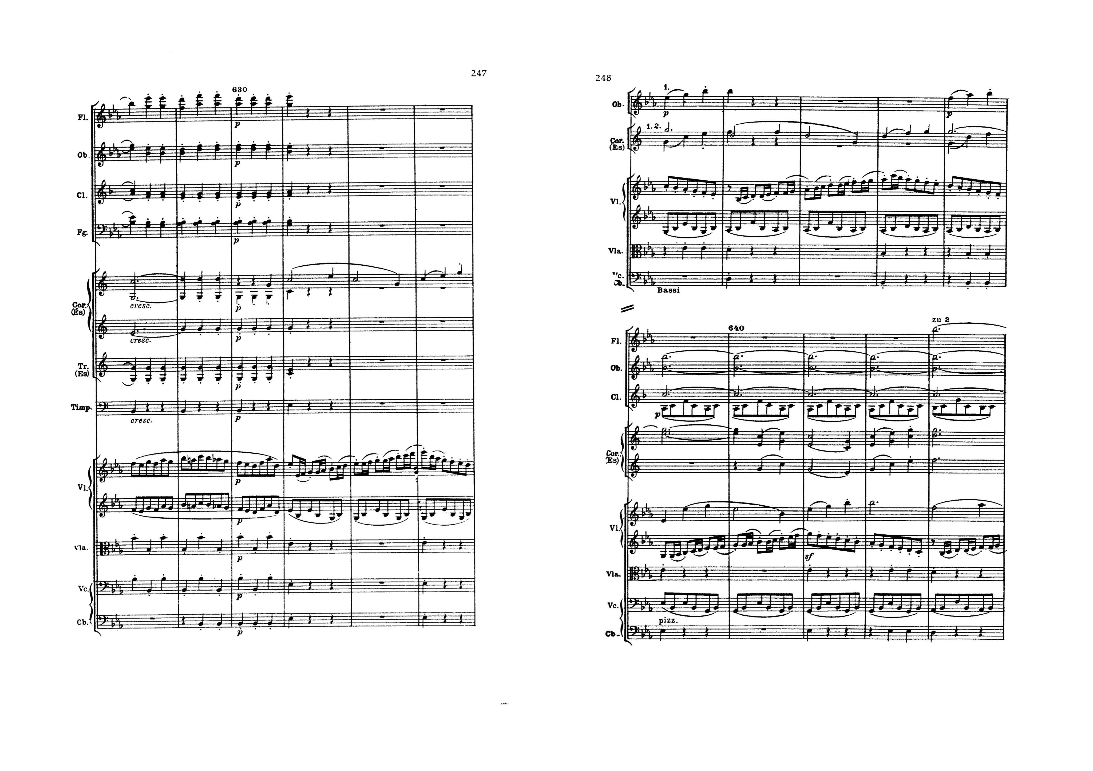

Slide 17
Beethoven’s symphonic achievements
For many nineteenth century observers he redefined what a symphony should/could be and massively increased its prestige and potential
Emphasised the idea of the symphony being a ‘journey’ or narrative, typically ‘from darkness to light’, and potentially presenting a heroic subject
Expanded the idea and possibilities of ‘organic’ development
Interplay of ‘Motif’ and ‘Motive’

Slide 18
1. Symphonic Prestige 2. Beethoven’s ‘Heroic’… 3. … and the ‘Symphony Concert’ 4. Mahler and the ‘Chain of Being’

Slide 19
The ‘Symphony Concert’
Formulated in first half of the nineteenth century
Heartland of bourgeois musical culture: open to all (for a price), in a dedicated concert hall by a specialist orchestra, reviewed in the press
Domain of the Bildungsbürgertum (‘educated middle classes’) who value and demand education, edification, autonomy and integrity (just as they do of their literature)
Cf typical concert behaviour (still practised in the present!)
Typical format: overture, concerto, grand symphony

Slide 20
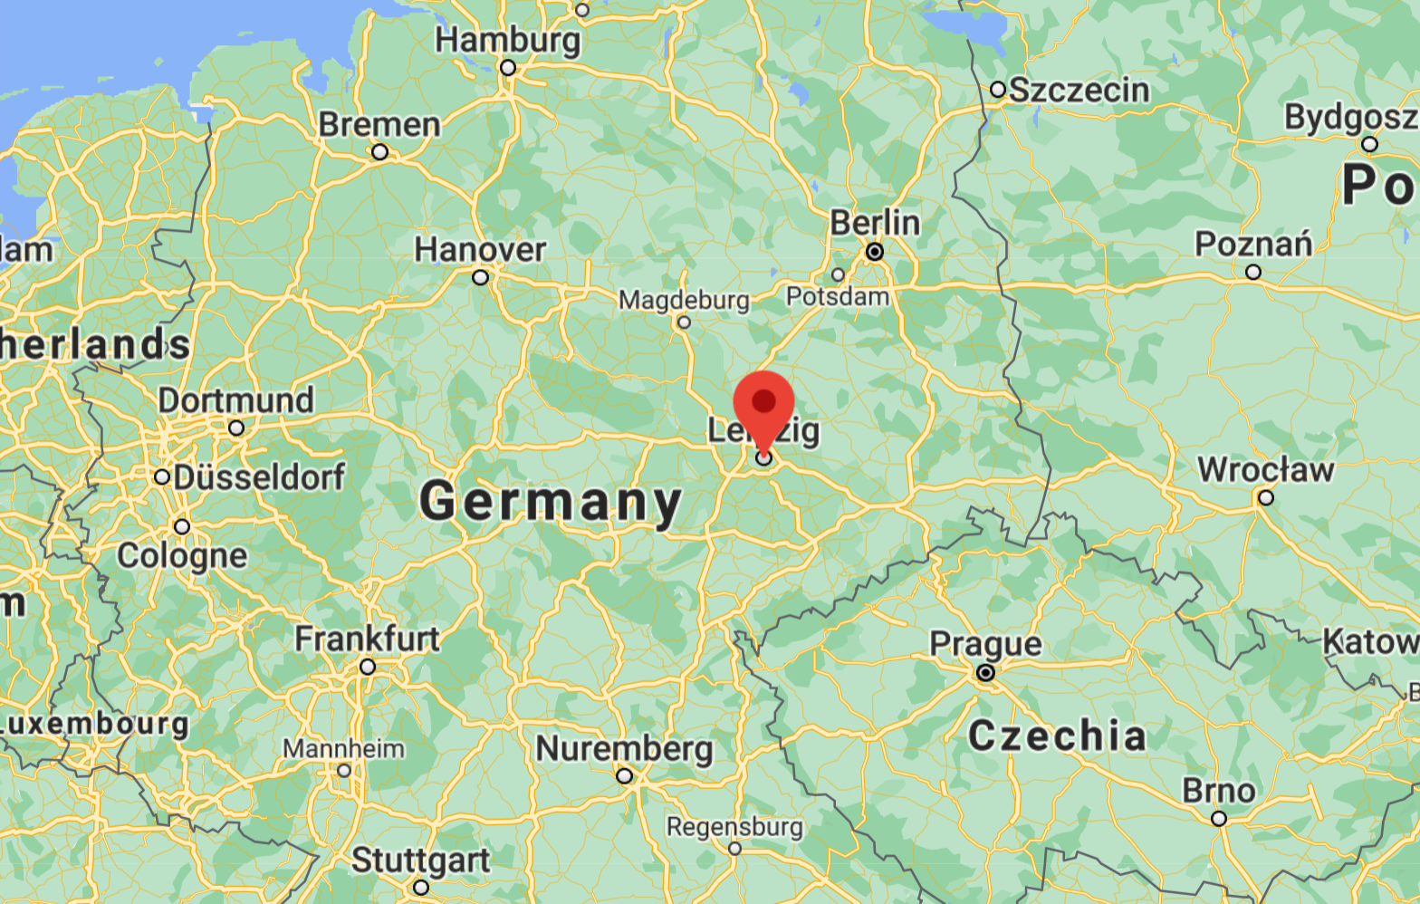
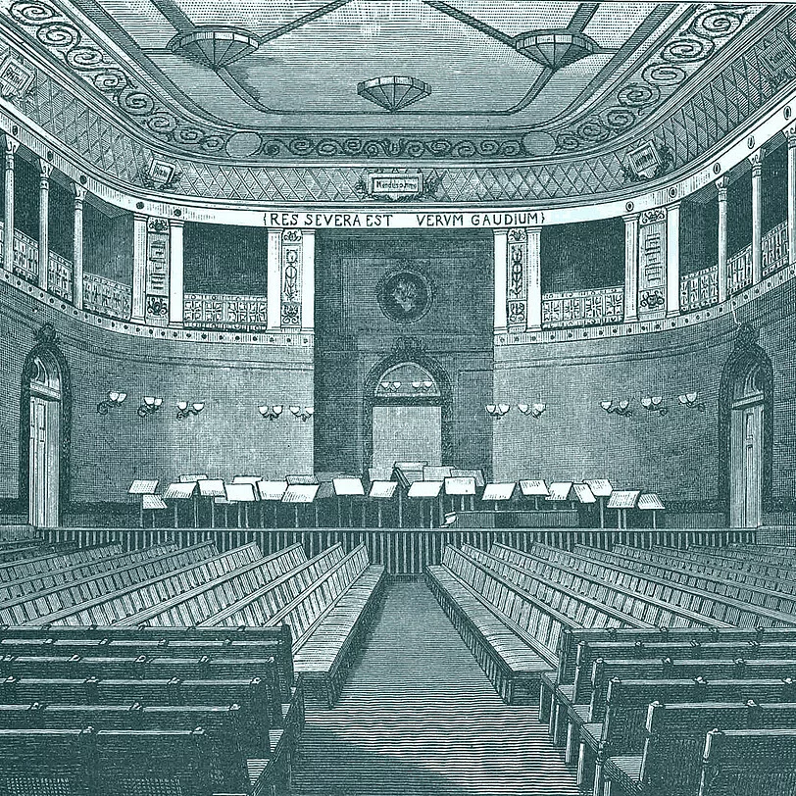
Leipzig as home of the Symphony Concert
Publishers, journals, conservatory, Thomaskirche (Bach legacy)…
Gewandhaus orchestra (first heard in 1781 in the ‘Clothiers’ Hall’): establishes the ‘serious’ symphony concert model of overture, concerto, symphony (second half of concert to itself), consolidates canon of German instrumental music
‘With a famous composer [Mendelssohn] at its head, the orchestra has brought its virtuosity to still greater perfection during the last few years. It has probably no German equal in its performance of symphonies’ (Schumann, Neue Zeitschrift, 1840)

Slide 21
1. Symphonic Prestige 2. Beethoven’s ‘Heroic’… 3. … and the ‘Symphony Concert’ 4. Mahler and the ‘Chain of Being’

Slide 22
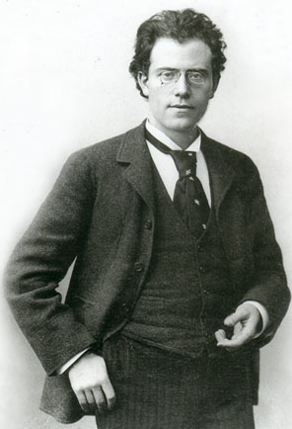
Gustav Mahler (1860-1911)
Representative of the ‘second age of the symphony’
From Jihlava (Czech Republic) but strongly associated with Vienna
Conductor and composer, renowned throughout Europe and the wider world
Compositional focus on the symphony (nine in total): challenges conceptual limits of symphony and symphony concert; idea of the symphonic ‘universe’

Slide 23
Symphony No. 3 (1896)
Framework for interpretation: Beethoven’s ‘darkness to light’ trajectory… but not of an individual ‘hero’…
Rather, a great ‘chain of being’:
I. Pan awakes – Summer marches in
2. What the Flowers in the Meadow Tell Me (Minuet)
3. What the Animals in the Forest Tell Me (Scherzo)
4. What Man Tells Me
5. What the Angels Tell Me
6. What Love Tells Me (Adagio)
‘To me, “symphony” means constructing a world with all the technical means at one’s disposal’ (1895, while working on Third)

Slide 24
1. Kräftig, entschieden
‘Pan awakes’
Opening horn call: history of the symphony? Beethoven, Brahms?
Followed by march… ‘it has almost ceased to be music; it is hardly anything but sounds of Nature’ (Mahler to Natalie Bauer-Lechner in 1896)
Musical vision of nature in the process of becoming

Slide 25
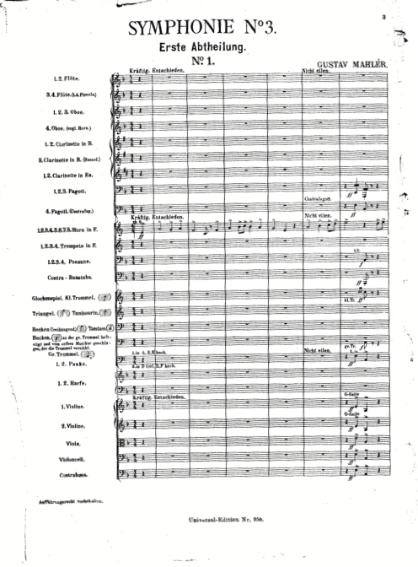
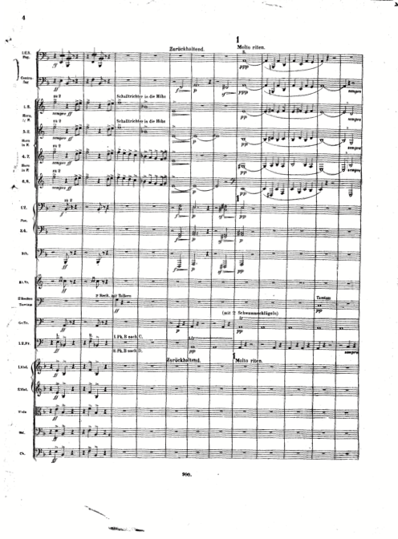

Slide 26
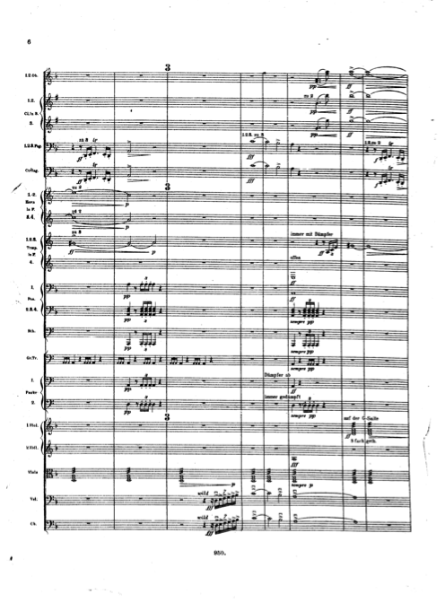
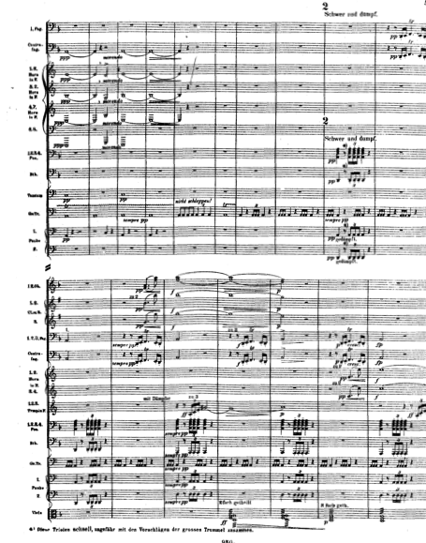

Slide 27
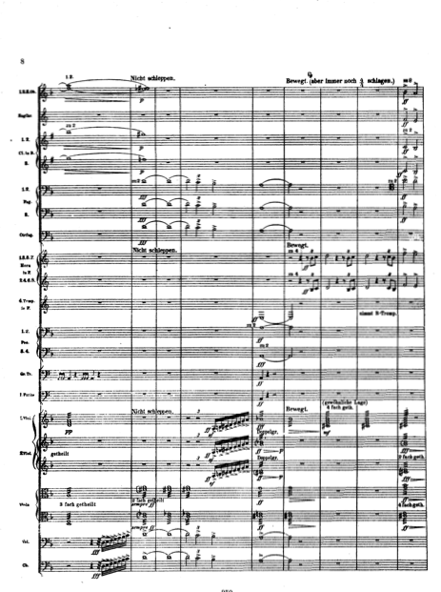
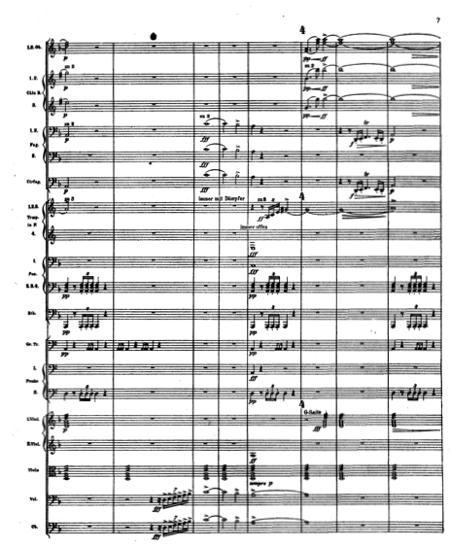

Slide 28
1. Kräftig, entschieden
‘Pan awakes’
Opening horn call: history of the symphony? Beethoven, Brahms?
Followed by march… ‘it has almost ceased to be music; it is hardly anything but sounds of Nature’ (Mahler to Natalie Bauer-Lechner in 1896)
Musical vision of nature in the process of becoming
‘Summer marches in’
Melodically trivial, ‘banal’, like a bad military band (‘Bachuszug’)

Slide 29
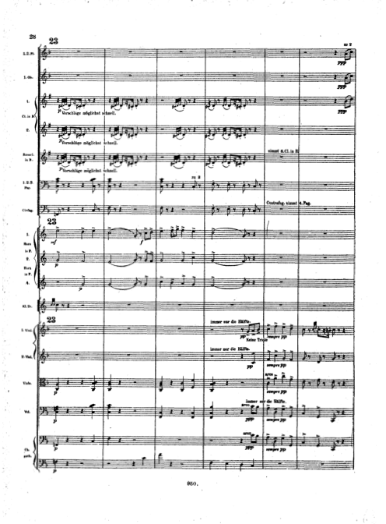
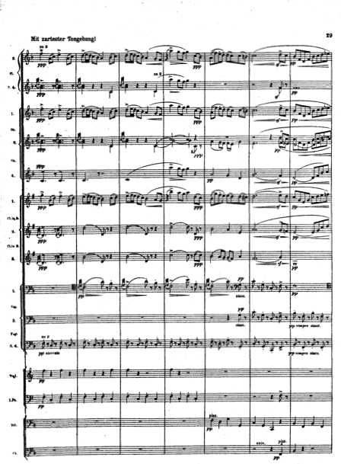

Slide 30
